Slide 1
Linkers and Loaders
Ruchika Patil
Assistant Professor,
Computer department
SPIT

Slide 2
Contents
Introduction
Linkers
Types of Linking
Basic Loader Functions
Types of Loaders

Slide 3
INTRODUCTION
The Source Program written in assembly language or high level language will be converted to object program, which is in the machine language form for execution.
This conversion either from assembler or from compiler, contains translated instructions and data values from the source program, or specifies addresses in primary memory where these items are to be loaded for execution.

Slide 4
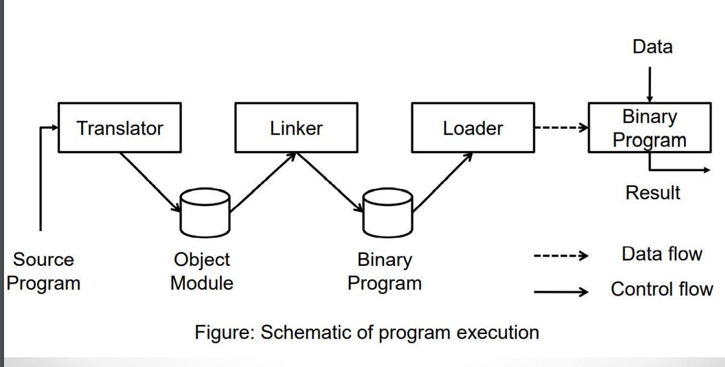
Source code -> compiler -> Assembler -> Object code -> Linker -> Executable file -> Loader

Slide 5
Linker
#include<stdio.h>
void main()
{
fun();
printf();
}
Libraries
010011100110
0011000101011

Slide 6
Linker (Link editor/ Binder)
Performs the process of linking: Helps to link object modules of a program into a single object file.
Linker also links a particular module into system library. It takes object modules from assembler as input and forms an executable file as output for the loader.

Slide 7
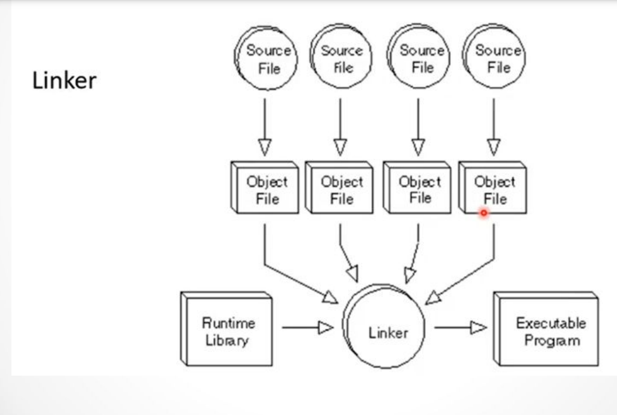

Slide 8
Types of Linking
Linking is of two types:
1. Static Linking
2. Dynamic Linking

Slide 9
Static linking
It is performed during the compilation of source program.
Linking is performed before execution in static linking.
When the program is loaded, the OS places only a single file to the memory which contains both: the source code and reference to the library.
Advantage & disadvantage?

Slide 10
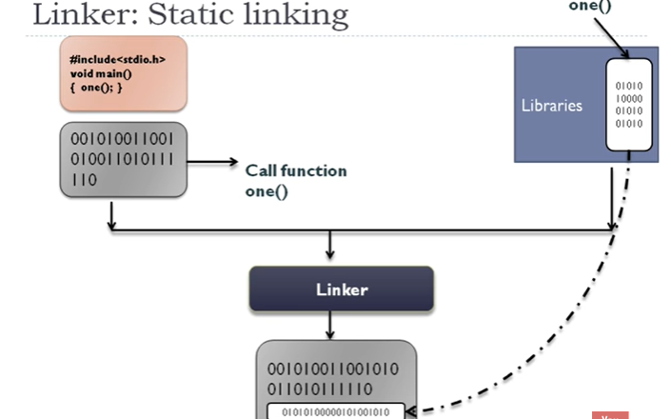
Linker

Slide 11
2. Dynamic Linking
Performed during the run time.
This linking is accomplished by placing the name of a shareable library in the executable image.
There are more chances of errors and failures.
It require less memory space as multiple programs can share a single copy of the library.
Here we can perform code sharing.

Slide 12
GATE-CS-2002
Dynamic linking can cause security concerns because:
(A) Security is dynamic
(B) The path for searching dynamic libraries is not known till runtime
(C) Linking is insecure
(D) Cryptographic procedures are not available for dynamic linking

Slide 13
Consider the following statements:
S1: When you statically link a file into an executable, the contents of the file are included during link time.
S2: When you link dynamically, it is only during run time when a pointer to the file which is linked in is included in the executable and then the contents of said file are loaded.
Which of the above statements is/are true?

Slide 14
Answer:
S1)correct because statically linking done in compile time
S2) correct, because dynamically linking done at run time.It linked the file by pointer to heap memory and we can access heap memory at runtime only. It's only include when you later run the executable that these dynamically linked files are bought in and they're only bought into the in-memory copy of the executable, not the one on disk.
Statically-linked files are 'locked' to the executable at link time so they never change. A dynamically linked file referenced by an executable can change just by replacing the file on the disk.

Slide 15
Design of Linker:
• Linking Loader
• Linkage Editor
• Dynamic Linking

Slide 16
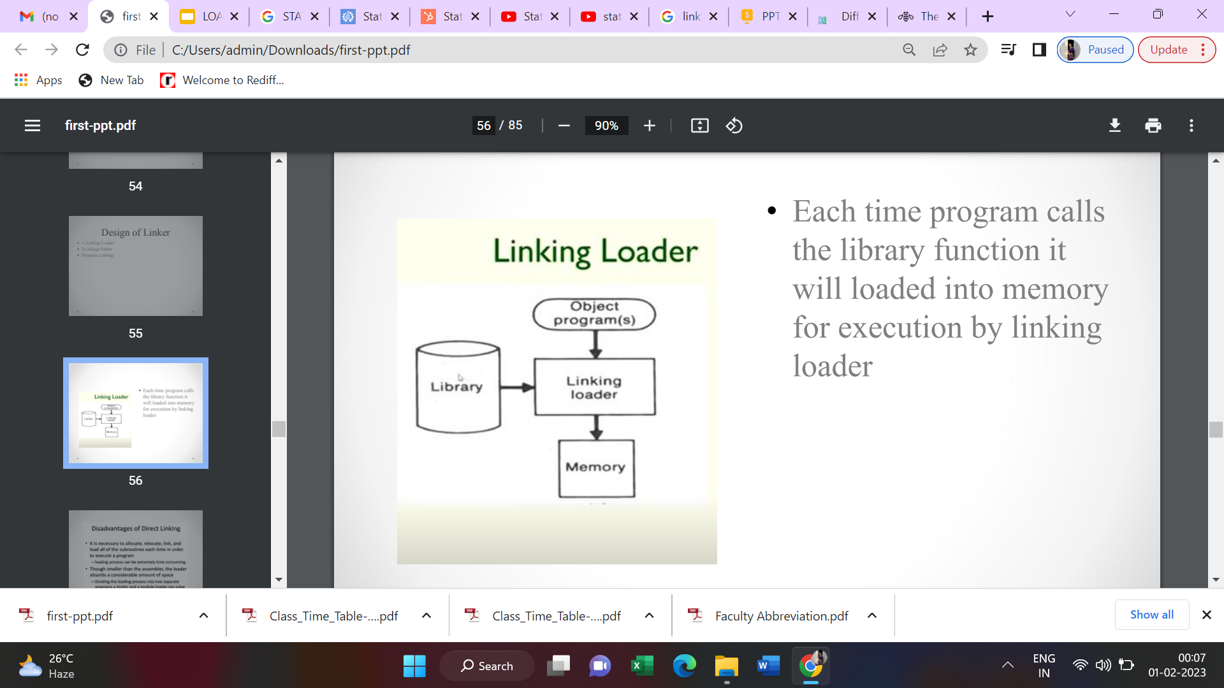
Linking Loader
Linking Loader performs all linking and relocation operations, including automatic library search, and loads the linked program into memory for execution.
Each time program calls the library function it will loaded into memory for execution by linking loader

Slide 17
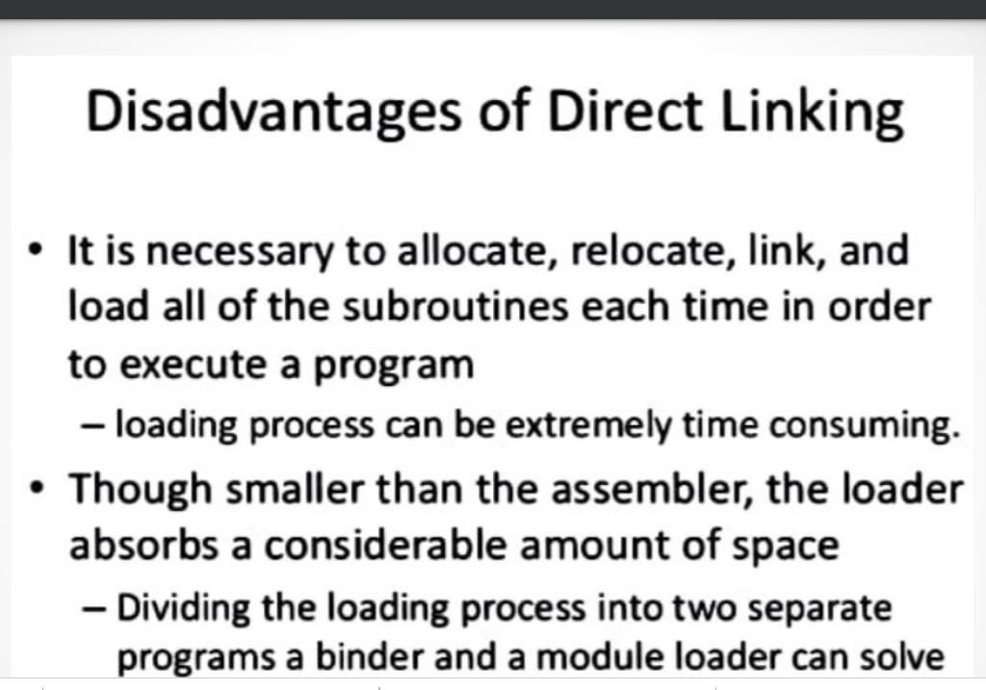

Slide 18
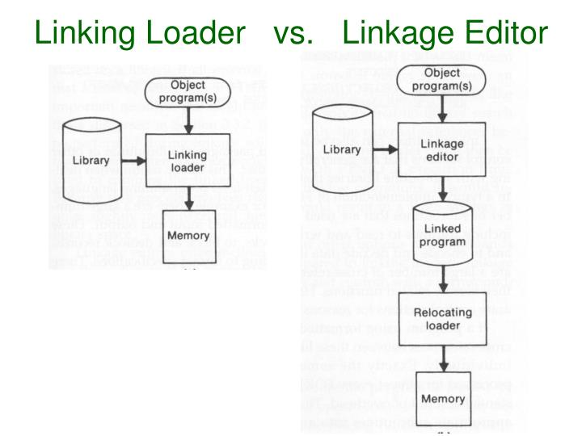

Slide 19
2) Linkage Editor
Linkage Editor Produces a Linked version of the program, which is normally written to a file or library for later execution.
If the object program calls the library function, the linkage editor will call the library and create the linked version of the program. So next when the same is required the loader will call this linked program so no need to load the library function again and again. If program is modified then I have to re-run it.

Slide 20
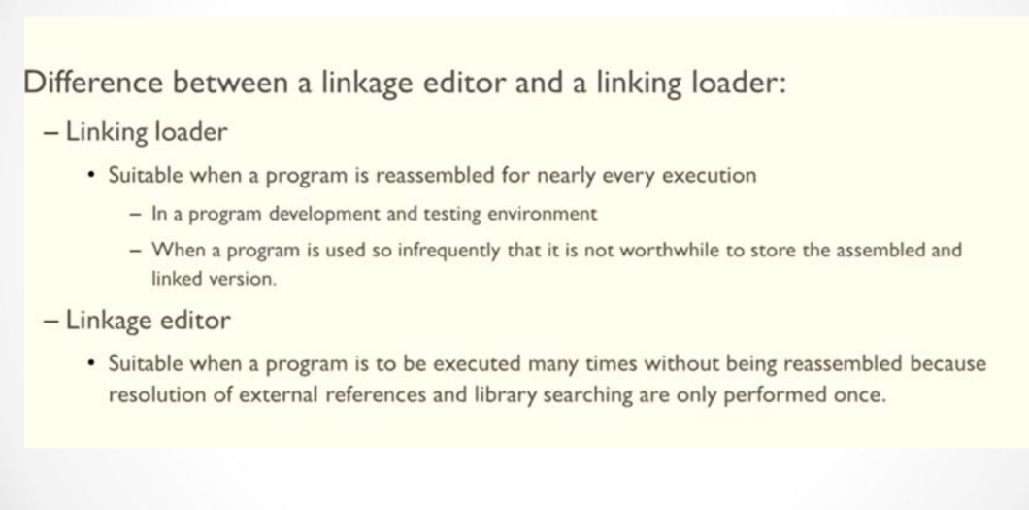

Slide 21
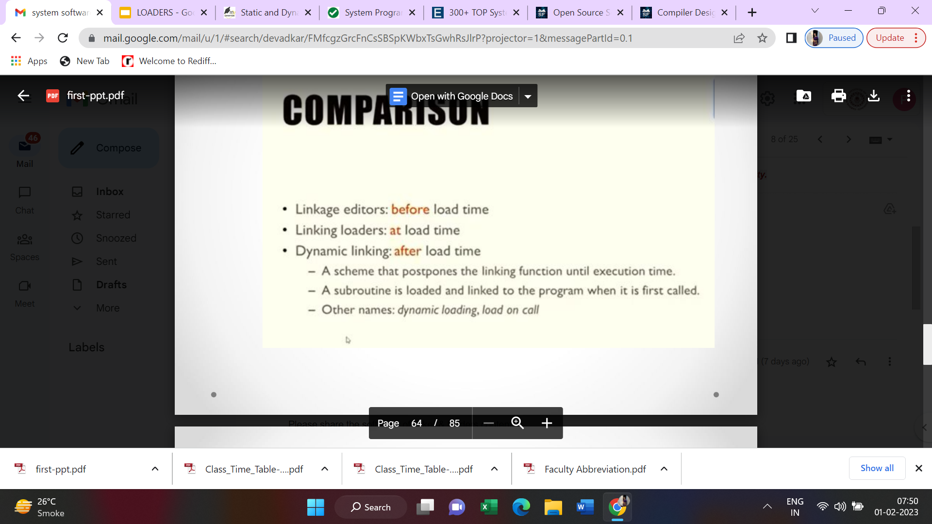

Slide 22
Loaders
Loader is utility program which takes object code as input prepares it for execution and loads the executable code into the memory. Thus loader is actually responsible for initiating the execution process.

Slide 23
Loader & its funtions:
It brings object program into memory and starts its execution.
Loader performs its task via four functions, these are as follows:
Allocation: It allocates memory for the program in the main memory.
Linking: It combines two or more separate object programs or modules and supplies necessary information.
Relocation: It modifies the object program so that it can be loaded at an address different from the location.
Loading: It brings the object program into the main memory for execution.

Slide 24
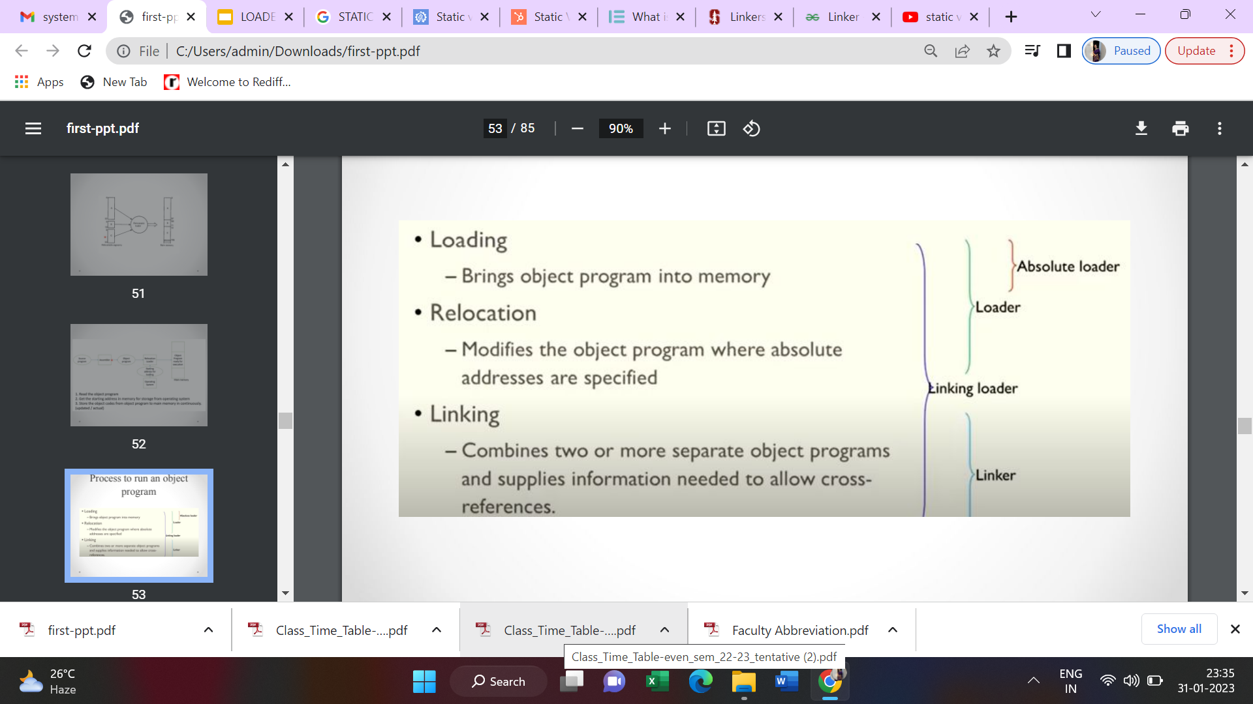

Slide 25
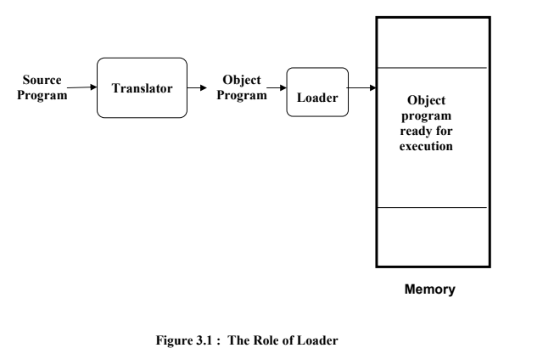

Slide 26
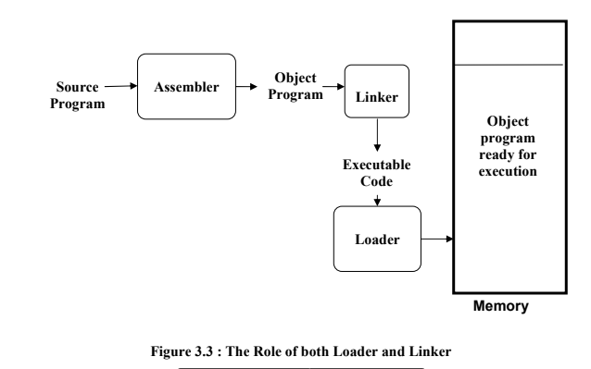

Slide 27
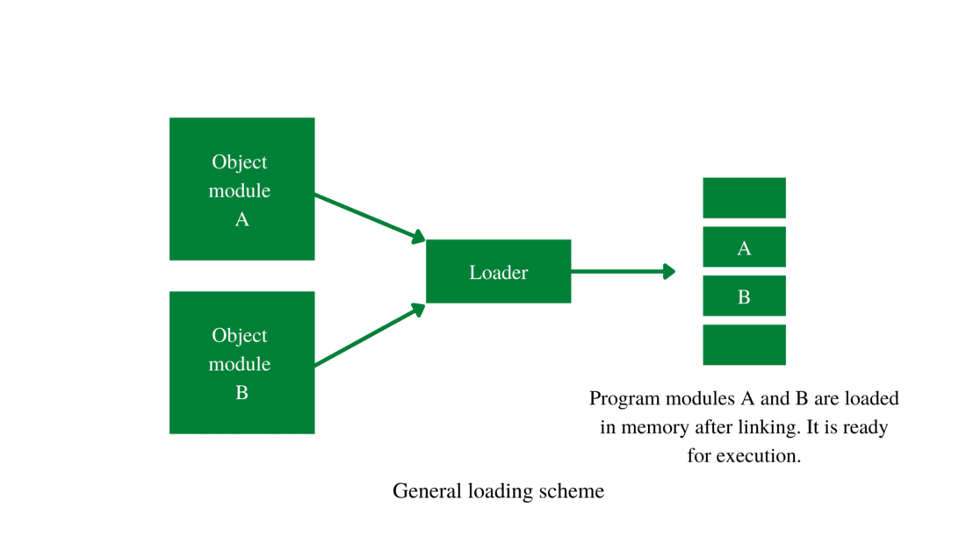

Slide 28
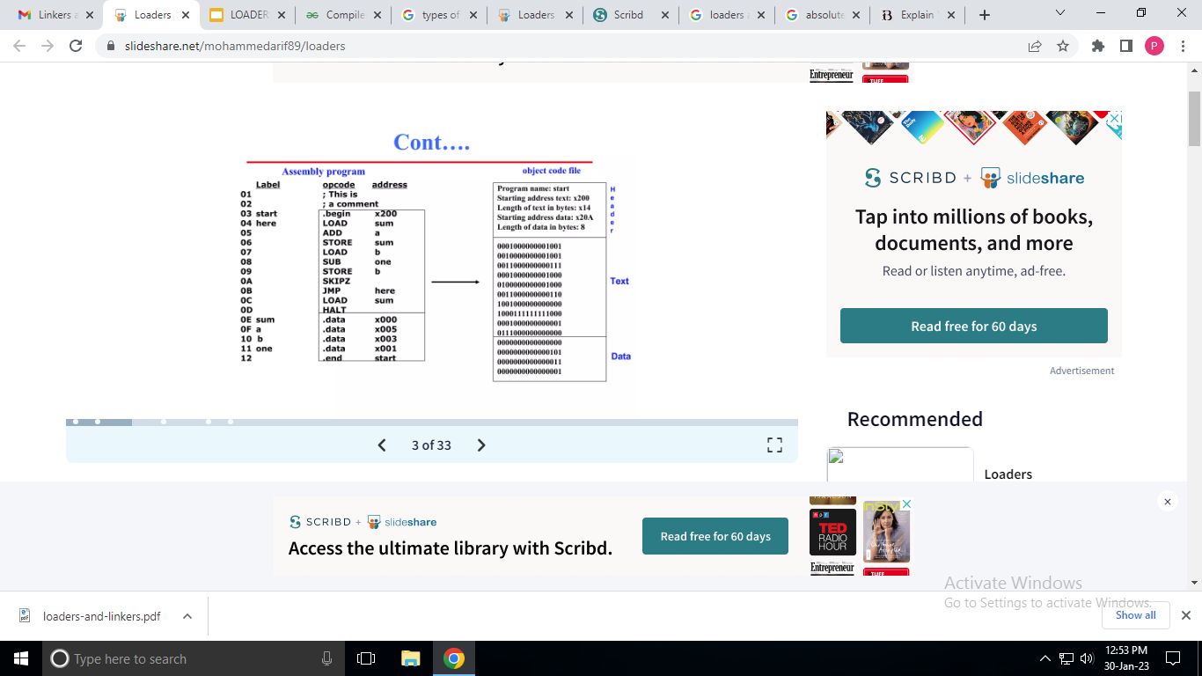

Slide 29
Allocation
In order to allocate memory to the program, the loader allocates the memory on the basis of the size of the program, this is known as allocation.
The loader gives the space in memory where the object program will be loaded for execution.

Slide 30
2) Linking
The linker resolves the symbolic reference code or data between the object modules by allocating all of the user subroutine and library subroutine addresses. This process is known as linking
Eg. printf(), scanf()

Slide 31
3) Relocation
There are some address-dependent locations in the program, and these address constants must be modified to fit the available space, this can be done by loader and this is known as relocation.
In order to allow the object program to be loaded at a different address than the one initially supplied, the loader modifies the object program by modifying specific instructions.

Slide 32
4) Loading
The loader loads the program into the main memory for execution of that program.
It loads machine instruction and data of related programs and subroutines into the main memory, this process is known as loading. The loader performs loading; hence, the assembler must provide the loader with the object program.

Slide 33
Types of Loaders

Slide 34
Types of Loaders
Different loading schemes:
General Loader Scheme
Absolute loader,
Compile and go Loader
Bootstrap loader,
Relocating loader (relative loader)
Direct linking loader.
Subroutine linkages

Slide 35
“Compile and go” loader
The instruction is read line by line, its machine code is obtained and it is directly put in the main memory at some known address.
That means the assembler runs in one part of memory and the assembled machine instructions and data is directly put into their assigned memory locations.
After completion of assembly process, assign starting address of the program to the location counter.
The typical example is WATFOR-77, it’s a FORTRAN compiler which uses such “load and go” scheme. This loading scheme is also called as “assemble and go”.

Slide 36
Disadvantages:
In this scheme some portion of memory is occupied by assembler which
is simply a wastage of memory. As this scheme is combination of assembler and loader activities, this combination program occupies large block of memory.

Slide 37
General Loader Scheme
In this loader scheme, the source program is converted to object program by some translator (assembler).
The loader accepts these object modules and puts machine instruction and data in an executable form at their assigned memory.
The loader occupies some portion of main memory.

Slide 38
Advantages:
The program need not be retranslated each time while running it. This is because initially when source program gets executed an object program
gets generated.
Of program is not modified, then loader can make use of this object program to convert it to executable form.

Slide 39
ABSOLUTE LOADER
The absolute loader transfers the text of the program into memory at the address provided by the assembler after reading the object program line by line.
Information that the object program must communicate from the assembler to the loader:
Machine instructions
Start of execution

Slide 40
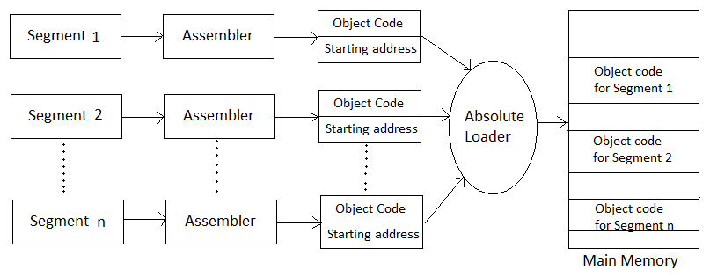

Slide 41
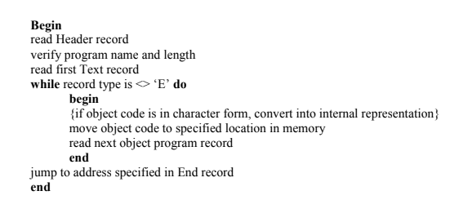

Slide 42
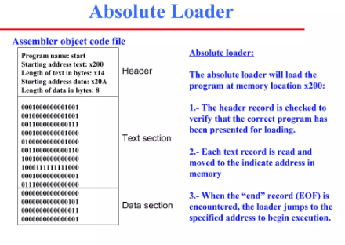

Slide 43
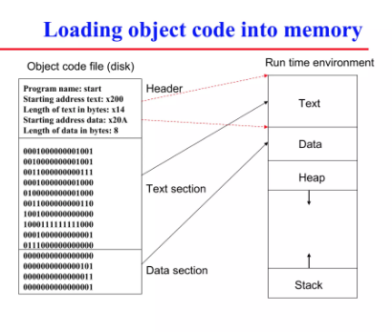

Slide 44
Compile and Go
Assembler does the process of compiling.
In this scheme, the source code goes into the translator line by line, and then that single line of code loads into memory.
Line-by-line code goes to the translator so there is no proper object code.
Because of that, if the user runs the same source program, every line of code will again be translated by a translator. So here re-translation happens.
WATFUR-77, a FORTRAN compile

Slide 45
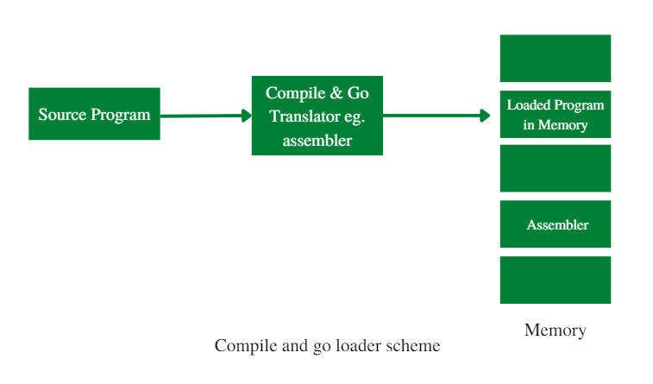

Slide 46
Simple bootstrap loader
When a computer is first turned on or restarted, a special type of absolute loader, called bootstrap loader is executed.
This bootstrap loads the first program to be run by the computer -- usually an operating system.
The bootstrap itself begins at address 0.
It loads the OS starting address 0x80. No header record or control information, the object code is consecutive bytes of memory.

Slide 47
Object Code

Slide 48
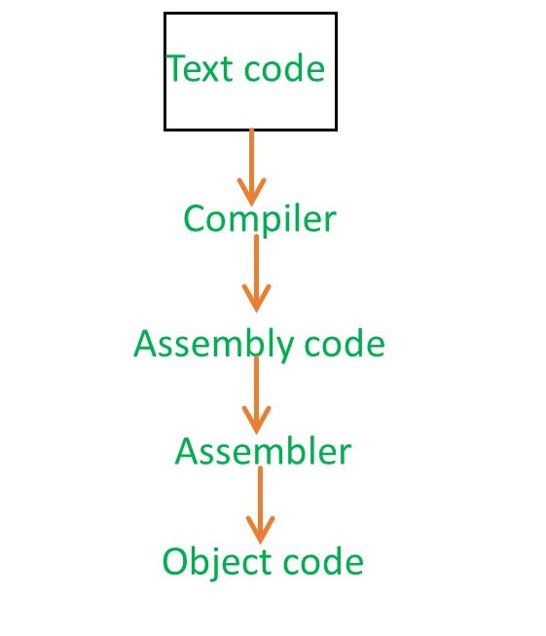
Object Code:
You give the C program to compiler and compiler will produce the output in assembly code.
Now,that assembly language code will give to the assembler and assembler is going to produce you some code. That is known as Object

Slide 49
